Slide 1
ASSIGNMENT 2
ANALYSIS OF 2 RESEARCH PAPERS
SOURISH
ROY

Slide 2
RESEARCH PAPERS
1) AN EXPLORATORY STUDY OF PULL BASED SOFTWARE DEVELOPMENT DEVELOPMENT MODEL (Georgios Gousios, Martin Pinzger, and Arie van Deursen)
2) ANALYZING FACTORS OF OPEN SOURCE PROJECT ALIVENESS (Rudi Chen, Ivens Portugal)

Slide 3
RESEARCH PAPER 1
AN EXPLORATORY STUDY OF PULL BASED SOFTWARE DEVELOPMENT DEVELOPMENT MODEL
ABSTRACT :
Instead of pushing changes to a central repository, developers pull them from other repositories and merge them locally.
In this work, the authors explore how pull-based software development works.

Slide 4
Introduction
Pull requests are the main means to contribute to a project.
Most pull requests are less than 20 lines long, processed (merged or discarded) in less than 1 day and the discussion spans on average to 3 comments.
Pull requests can be versioned across various repositories and authorship information is also effortlessly maintained.
Core developers can access all information that relates to a pull request and solicit opinions of the community about the merging decision.

Slide 5
How are they related to our RQs?
1) We see pull messages in our commit logs. Before analyzing them we need to develop a deep understanding of how pull requests help to synchronize multiple development efforts .
2) Why do we see so many pull requests? Can we get the developer information from this?
3) Most contributions come in the form of direct code modification. A code contribution can be made either directly (pushed commits) or indirectly (pull requests).
The former are exclusively performed by developers granted write permission on the project, while the latter can come from anyone.
This could give us an idea of how popular this project is amongst devs. Our RQ4.

Slide 6
This paper mainly focuses on the pull based architecture:
Project
Fork
Core Team
Contributor
create
fork
commit(1)
commit(2)
Pull Req
create
inspect
comment
commit
merge
comment
commits are pulled
close

Slide 7
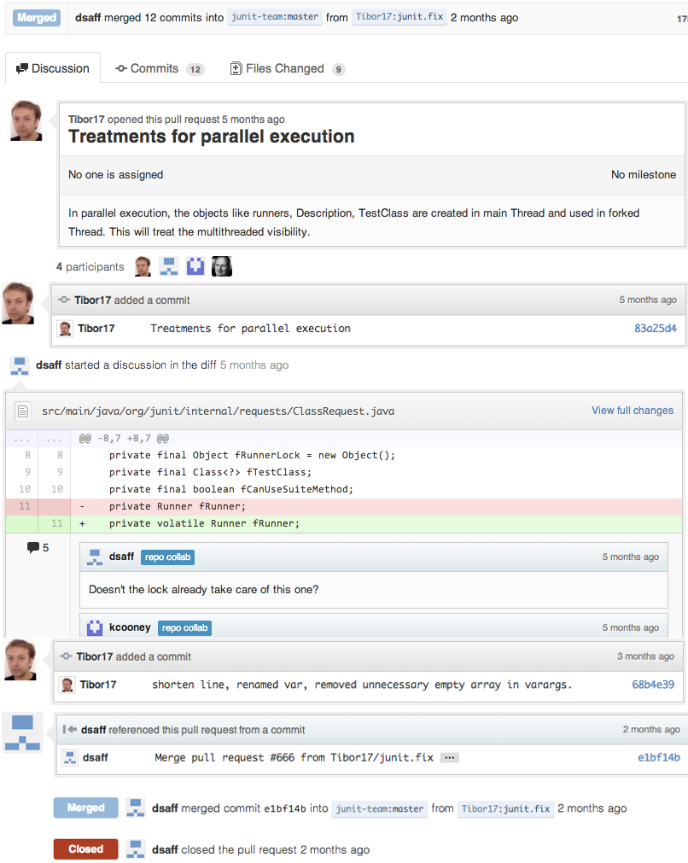
An example Github pull request
The participants first interact in a code review, the result of which is a new commit.
The second reviewer then merges the pull request

Slide 8
Data used
Github data as provided through a project named GHTorrent, an off-line mirror of the data offered through the Github API.
A wide variety of machine learning and feature extraction techniques have been used in this paper.
Cross validation techniques have been used as well.

Slide 9
The methodology
In particular, the authors investigate such questions as how many projects actually make use of pull requests
How many of the projects are original repositories (versus, e.g., clones)
They had run each dataset through 4 well known classification algorithms, namely Random Forests, Support Vector Machines, Binary Logistic Regression and Naive Bayes.
Select the best classifier and apply a classifier-specific process to extract the feature importance.

Slide 10
RESULTS
PULL REQUEST Lifecycle Analysis →
In their dataset, most pull requests (84.73%) are eventually merged.
They check whether the pull requests originating from main team members are treated faster than those from external contributors.
They performed an unpaired Mann-Witney test among the times to merge pull requests from each group.
They found that merged pull requests received no special treatment irrespective of whether they came from core team members or from the community.

Slide 11
Conclusions
Contributors →
Prospective project contributors want their contributions to be accepted. This research shows that pull requests that affect parts of the project that have been changed often lately (are “hot”) are very likely to get merged .
“keep it short” (less than 100 lines)
Core team →
Their job is to either accept or reject the pull requests based on the following table.

Slide 12
Reasons for closing pull requests without merging
Reason Description (PR-> pull req) %
obsolete The PR is no longer relevant, as the project 4 has progressed.
conflict There feature is currently being implemented 5 by other PR in another branch.
superseded A new PR solves the problem better. 18
duplicate The functionality already exists in the 2
project.
superfluous PR doesn’t solve an existing problem or add 6
a feature needed by the project.
deferred Proposed change delayed for further investi-
gation in the future. 8
process The PR does not follow the correct project 9
conventions for sending and handling pull re-
quests.
tests Tests failed to run 1

Slide 13
RESEARCH PAPER 2
Analyzing Factors Impacting Open-Source Project Aliveness
ABSTRACT:
Developers would like to know if an open-source project will be alive in the future before contributing or using its source code, so that they know that contributions will impact other developer’s work, and that security updates or bug fixes will be implemented.

Slide 14
INTRODUCTION
Open-source projects, whose source code is publically available, allow developers to use existing code, make changes, and contribute back.
However, not all projects remain active. Developers may lose interest in an open-source project, the departure of the key maintainers may lead to a lack of direction in the project or users may shift to another solution.
This paper investigates the factors that contribute most to open-source project aliveness and discover whether it is possible to predict the chances of a particular project being alive in the future.

Slide 15
How are they related to our RQs?
The paper shows that fixes are always a necessary contribution in a project. These keywords can be seen after analyzing our commit messages. So we can check how many effective fixes have been added to a project.
This paper is directly related to our RQ 3 and will help us in getting an idea about the project aliveness.
The table 2 shown later is almost an exact replica of our data set.

Slide 16
DATA USED
This paper analyzed 8 million GitHub projects from the Boa’s dataset and studied almost 70,000 projects.
This paper starts by brainstorming factors that are expected to contribute to project aliveness. For example, authors hypothesize that the number of recent commits by the founder of the project is an important factor.
From these, they compute a set of features and labels over the revision history of repositories(from the log files) and then, use a machine learning approach(decision trees) and create a project aliveness predictor.

Slide 17
DATA SET
Project Information | Description
ID | An unique project | Identifier | for | the
Name | The name of the project (including “/” and the username)
Number of commits | Number of commits since the creation of the project
Presence of documentation files | Whether this project contains documentation files
Project creation time | Project creation time
Number of programming languages | Number of programming lan- guages in the source code of the project
Commit Information | Description
ID | An unique identifier for the commit
Project ID | The ID of the project this commit belongs to
Commit time | The time this commit happened
Author username | The username of the committer
Table 2: Commit information extracted from the Boa dataset
Table 1: Project information extracted from Boa dataset

Slide 18
The methodology
Labels → In this study, a project is said to be alive if there is at least one commit after the cutoff date.
Features → The authors analyze 15 features to discover their importance on open-source project aliveness. (Number of commits/commiters, committers with multiple commits, committers sticking at least a day/week, Percentage of commits – founder, top 2, top 3, top 5, Days after last commit, Days after last founder commit, Largest gap between two consecutive commits, Density of commits, Project age and Number of programming languages )
Authors have compared the distribution of values for projects marked as ‘alive’ and projects marked as ‘dead’, using tools such as boxplots. This can help gain more insight into individual features.

Slide 19
Results
Number of days | Number of projects
[0,0] | 86838
[1,2] | 16087
[3,6] | 16918
[7,14] | 18267
[15,30] | 19342
[31, 62] | 19187
[63, 126] | 17539
[127, 254] | 13984
[255, 510] | 11745
[511, 1022] | 7422
[1023, 2046] | 4153
[2047, 4096] | 1265
[4095, 8190] | 194
[8191, 16382] | 61
Table : The Lifespan of projects in the data set
Almost 90,000 repositories have all their commits in less than one day

Slide 20
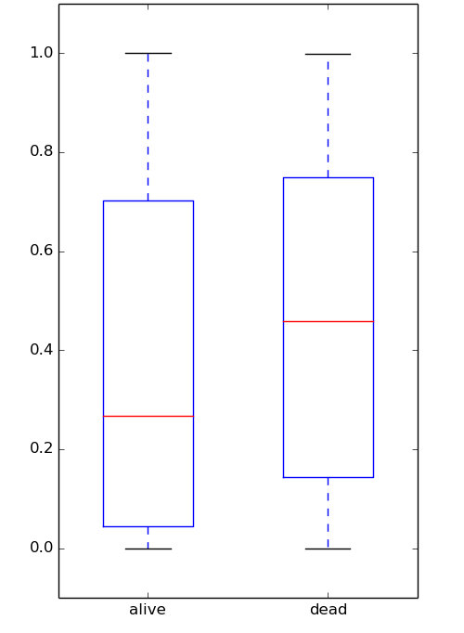
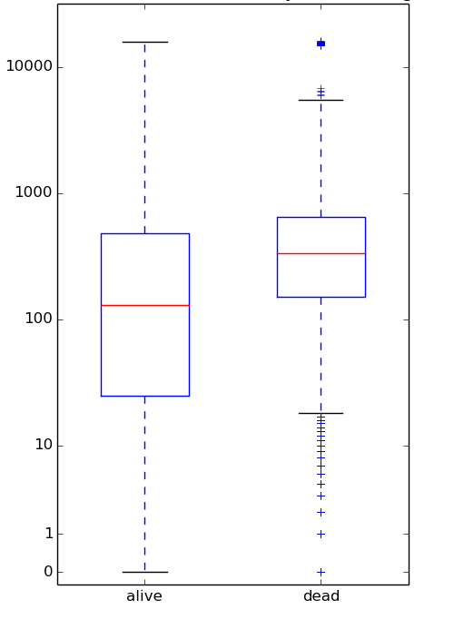
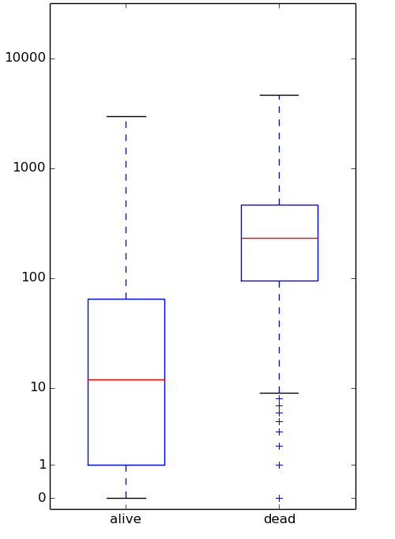
Box plots of the distribution of the values of features related to the project founder. (Impact of Project Founder)
a) Percentage of class commits by founder when the project is alive or dead.
b) Number of days since the last commit by the founder.
c) Number of days since the last commit by any developer

Slide 21
Documentation Activity
 | Last commit within 7 days |  |  | Last commit within 30 days
 | Alive | Total | % | Alive | Total | %
readme | 2147 | 41782 | 5.1% | 5252 | 41782 | 12.6%
license | 1035 | 16210 | 6.3% | 2392 | 16210 | 14.8%
todo | 582 | 8943 | 6.5% | 1256 | 8943 | 14.0%
install | 359 | 4855 | 7.4% | 680 | 4855 | 14.0%
contributing | 218 | 3028 | 7.2% | 448 | 3028 | 14.8%
changelog | 243 | 3407 | 7.1% | 498 | 3407 | 14.6%
One of the above | 2835 | 53904 | 5.3% | 6752 | 53904 | 12.5%
Two of the above | 1203 | 16641 | 7.2% | 2641 | 16641 | 15.9%
All projects | 3394 | 68299 | 5.0% | 3394 | 68299 | 5.0%
Table: Likelihood of a project having recent contribution activity given the presence of documentation files.

Slide 22
CONCLUSIONS
Results show that date features, such as the number of days since the last commit, are good predictors of project aliveness, with more than 80% accuracy.
Later the machine learning techniques used in the paper confirm that date features were the best predictor of future aliveness
Additionally, the impact of the percentage of founder commits is significant, and the presence of documentation files, when not named “README”, correlate with future project aliveness.
When analyzing the impact of the project founder on project aliveness, it is seen from the box plots that when the percentage of the founder commits is low, the project is more likely to remain alive in the future.
The authors expect that these results would help developers in their choice of open-source project in GitHub, when looking for projects to work with.

Slide 23
Threats to validity
Conclusion Validity → After stating all it’s experiments the paper states that backtesting needs to be done to validate their process which is redundant and time consuming.
Labels Validity → In this study, a project is said to be alive if there is at least one commit after the cutoff date. But this is not always true.
For example, it may be the case that the project needs only a yearly update to work with the latest Linux release and fix an occasional security bug. They would not call such a project “dead” even though it actually is.

Slide 24
Thank You!!

